Slide 1













DIGITAL CLOCK
STIMULATION
Stimulation using Multisim
INSPIRED BY

Slide 2
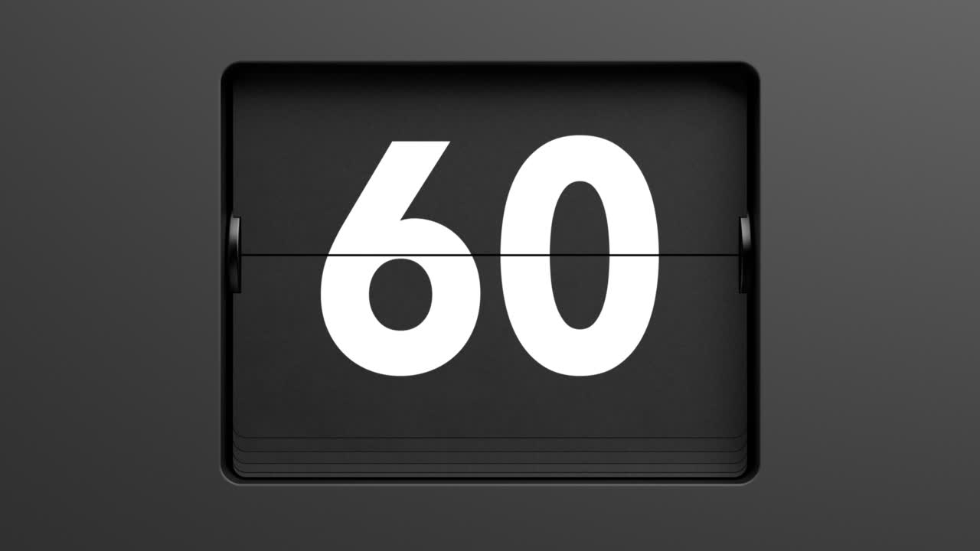
WHAT WE WILL COVER
What is a Digital Clock
Components used
How does it works

Slide 3

COMPONENTS USED
1.) BCD TO 7-SEGMENT DISPLAY DECODER
2.) 7-SEGMENT DISPLAY
3.) DECADE COUNTERS

Slide 4
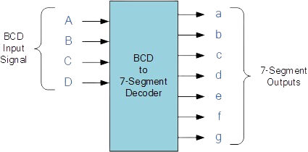
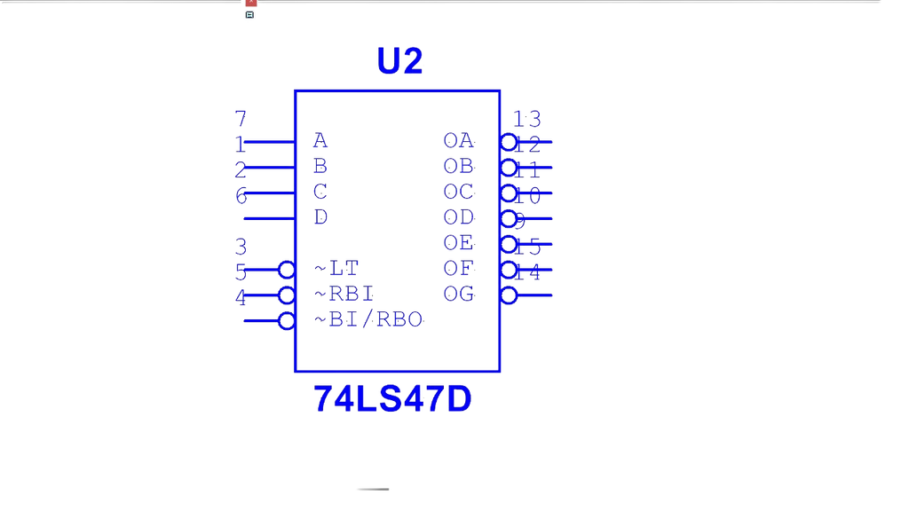
BCD TO 7-SEGMENT DISPLAY DECODER
N
A BINARY-CODED DECIMAL (BCD) TO 7-SEGMENT DISPLAY DECODER IS A DIGITAL CIRCUIT THAT CONVERTS A BINARY-CODED DECIMAL INPUT INTO A FORMAT THAT CAN BE DISPLAYED ON A 7-SEGMENT DISPLAY.
-> EACH OUTPUT WILL BE PRODUCED FOR ONLY ONE POSSIBLE COMBINATIONS OF INPUTS
-> IT HELP TO RETRIVE THE DATA DEVELOPED BY COUNTER WERE ENCODED.

Slide 5
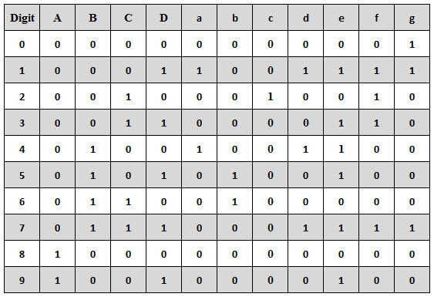
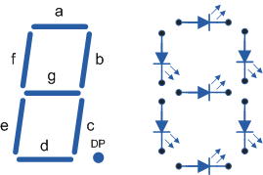
7-SEGMENT DISPLAY DECODER
SEVEN SEGMENT DISPLAY :
A 7-SEGMENT DISPLAY IS A COMMON OUTPUT DEVICE USED TO DISPLAY DECIMAL NUMBERS AND SOME ALPHANUMERIC CHARACTERS.
IT CONSISTS OF SEVEN LED SEGMENTS ARRANGED IN THE SHAPE OF THE NUMBER "8."
SEVEN SEGMENT DISPLAY DECODER:
A 7-SEGMENT DISPLAY DECODER IS AN ELECTRONIC CIRCUIT OR DEVICE USED TO CONVERT BINARY OR BCD (BINARY CODED DECIMAL) INPUTS INTO SIGNALS THAT CAN BE DISPLAYED ON A 7-SEGMENT LED (LIGHT EMITTING DIODE) DISPLAY.

Slide 6
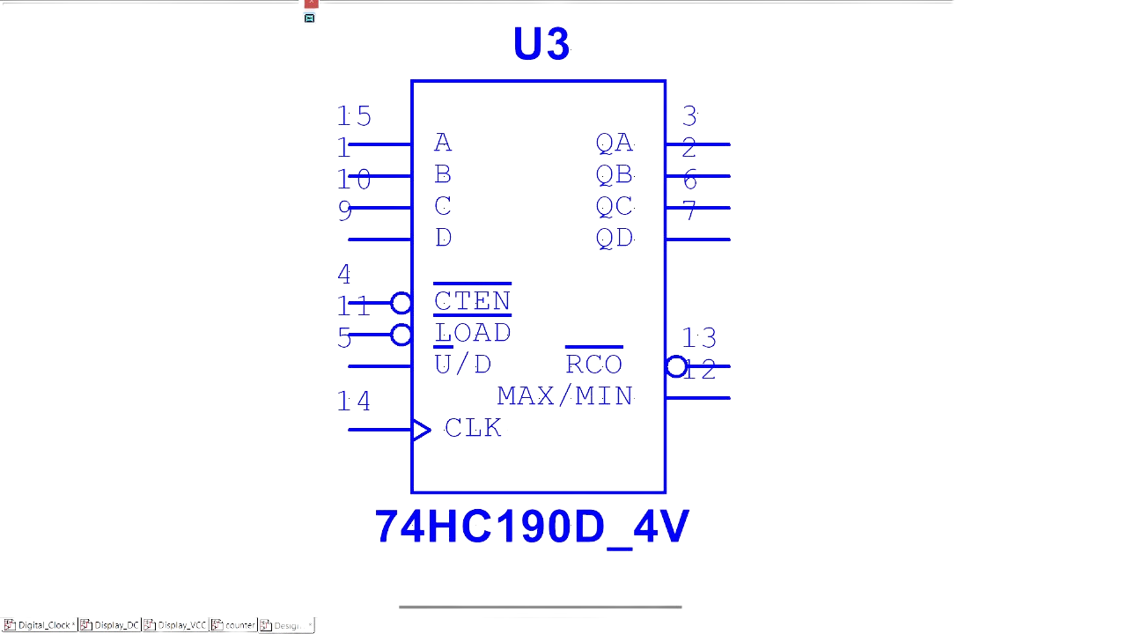
DECADE COUNTER
A DECADE COUNTER IS A SERIES TYPE OF DIGITAL COUNTER WHICH IS DESIGNED TO COUNT TEN DIGITS.
THE VALUES THAT A BCD COUNTER COUNTS ARE 0, 1, 2, 3, 4, 5, 6, 7, 8, AND 9 IN BINARY FORMAT
THE COUNTER WHICH WE USED IS 74HC190 WHICH IS A SYNCHRONOUS DECADE COUNTER
IN THIS COUNTER IC A, B, C AND D ARE LOAD INPUTS WHICH ARE CONNECTED TO THE INDIVIDUAL FLIP-FLOPS INSIDE THE COUNTER.
OA, QB, QC AND QD ARE THE INDIVIDUAL BINARY OUTPUTS REPRESENTING THE CURRENT COUNT STATE IN A FOUR BIT BINARY FORMAT.

Slide 7
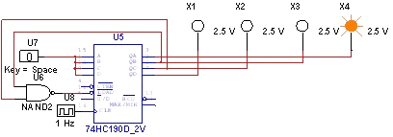
MOD-6 COUNTER
A MOD-6 COUNTER IS A TYPE OF DIGITAL COUNTER CIRCUIT THAT COUNTS MODULO 6, WHICH MEANS IT COUNTS UP TO SIX STATES BEFORE RESETTING TO ZERO.
IT CAN BE MADE USING A DECADE COUNTER AND FEEDING THE NANDED OUTPUT OF QB AND QC TO THE ¯( LOAD).
WHENEVER THE COUNT REACHES 0110 I.E. 6 IN DECIMAL THE COUNT STARTS AGAIN FROM 0000 I.E. 0 IN DECIMAL.

Slide 8
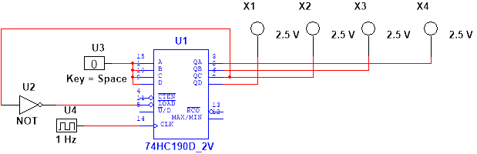
MOD-4 COUNTER
A MODULO 4 (MOD-4) COUNTER CIRCUIT CAN BE MADE USING A DECADE COUNTER AND FEEDING THE NOT OUTPUT OF QC TO THE ¯( LOAD)
WHENEVER THE COUNT REACHES 0100 I.E. 4 IN DECIMAL THE COUNT STARTS AGAIN FROM 0000 I.E. 0 IN DECIMAL.

Slide 9
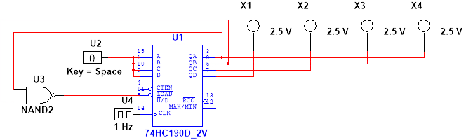
MOD-3 COUNTER
A MODULO 3 (MOD-3) COUNTER CIRCUIT CAN BE MADE USING A DECADE COUNTER AND FEEDING THE NANDED OUTPUT OF QB AND QC TO THE ¯( LOAD)
WHENEVER THE COUNT REACHES 0011 I.E. 3 IN DECIMAL THE COUNT STARTS AGAIN FROM 0000 I.E. 0 IN DECIMAL.

Slide 10
